Slide 1

INFLUENCE OF SURFACE CONDITIONS AND ANGLE OF ATTACK ON AIRBRAKE DRAG
ME30801 Fluid Mechanics Lab, Open Lab Project
Division 1, Team 19
Agathiya Tharun, Joe Misenar, and Pranav Madhavan
School of Mechanical Engineering, Purdue University

Slide 2

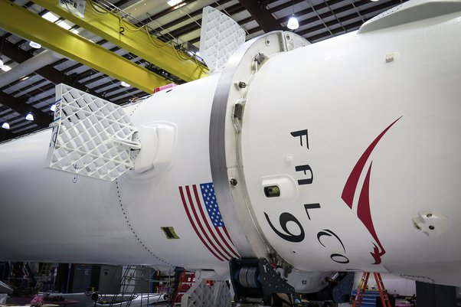
Background
Airbrakes control rocket trajectory, speed, and apogee.
Wind tunnels can be used to characterize the drag acting on a rocket’s airbrakes during its ascent.
Purdue Space Program – Spaceport America
Designing SEDS’ first ever airbrake system
Notes:
Airbrakes are extremely important in helping steer a rocket in a particular direction as well as controlling its speed
This experiment aims to characterize the drag acting on a rocket during its ascent

Slide 3
Objective
The team’s objective is to characterize the drag experienced on proposed airbrake designs by measuring the resistive forces on various test configurations. The ultimate goal is to determine the drag forces the airbrake will experience at higher velocities in true conditions during launch by extrapolating results from the team’s test data.

Slide 4
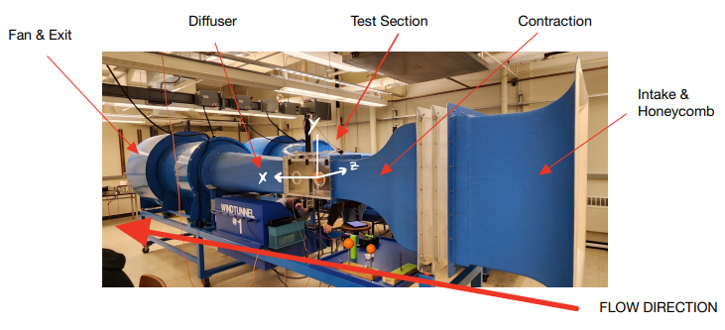
Facilities and Instruments
Facilities:
Wind Tunnel (ELD Model 402B)
Bechtel Innovation Design Center
Mallott Machine Shop
Instruments:
Dynamometer (LVDT)
Data Acquisition System

Slide 5
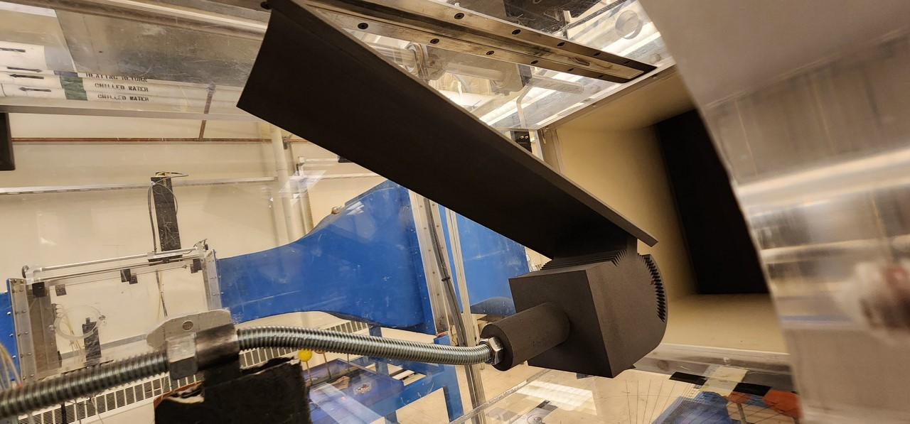
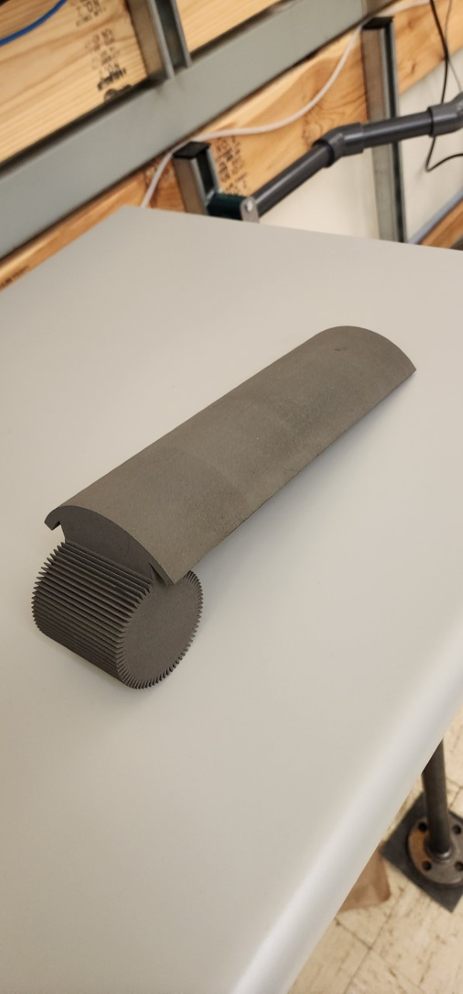
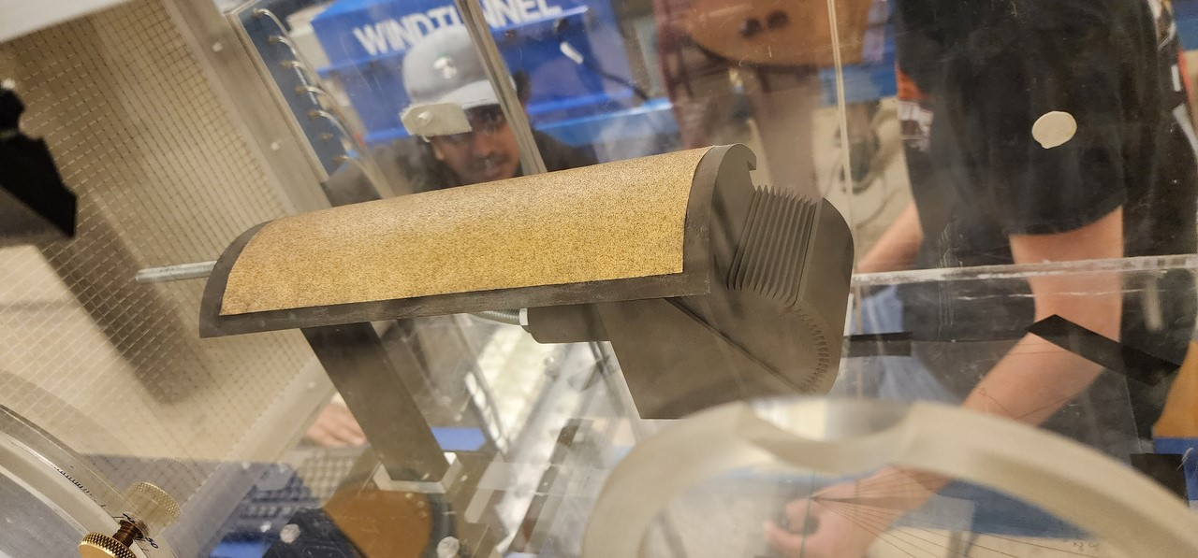
Test Model Description
Angled all-thread rod (Zinc-plated)
FUSE 1 3D Printed hub (Nylon)
FUSE 1 3D Printed Jig for calibration (Nylon)
FUSE 1 3D Printed Airbrake (Nylon)
Smooth printed surface - laminar flow
Surface layered with 100 grit sandpaper - turbulent flow

Slide 6
Test Plan
Bent all-thread rod to lower model within test section to avoid interference.
Measure drag with only LVDT test stand and jig for calibration at 0Hz
Repeat at 60Hz with calibration jig at angles of angles of attack from 0° to 30° at steps of 5°
Measure drag with airbrake and test stand for calibration at 0Hz
Repeat at 60Hz with full model at angles of attack from 0° to 30° at steps of 5°
Notes:
All thread bent to allow airbrake to be tested at 30deg wo interfering top of test section. Using jig in calibration out the drag force effects of the frontal projected area of the exposed jig and allows for only the drag force effects of the top surface of the airbrake to be measure. 60hz is 44.66m/s

Slide 7
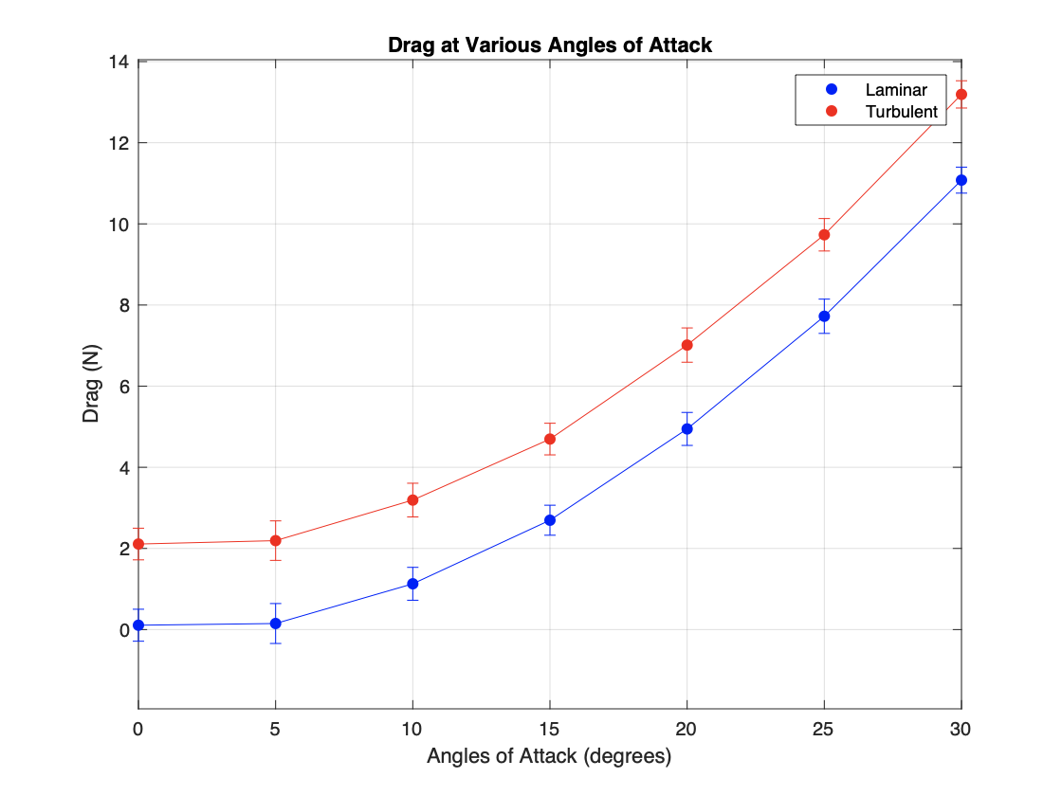
Results (Drag Force)
Flow Type | Minimum Drag (N) | Maximum Drag (N)
Laminar | 0.394 | 11.078
Turbulent | 2.109 | 13.192

Slide 8
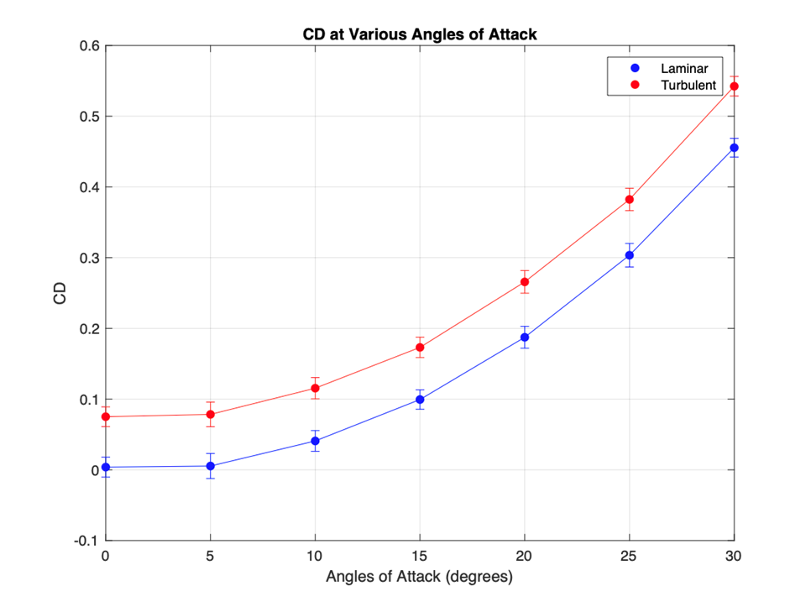
Results (Coefficient of Drag)
Flow Type | Minimum Drag (N) | Maximum Drag (N)
Laminar | 0.0038 | 0.4555
Turbulent | 0.0751 | 0.5424
Notes:
The team reparsed the data to investigate the effects of angle of attack on the coefficient of drag of the airbrake. Evidently, it follows a similar trend as the drag force results and increases exponentially with angle of attack. As the angle increases, the projected area does so as well. Turbulent flow carries larger velocities closer to the wall and thus has more momentum. This higher momentum delays boundary layer seperation and generates a smaller wake. A lower wake area increases the pressure behind the body, reducing the change in pressure across the model and thus reduces form drag. For a bluff body, form drag is the largest contributor – reducing this form drag with a turbulent flow causes the total drag to decrease despite the increase in skin friction drag that results from the turbulent airflow. As seen by the fact that the drag force is larger for the rougher surface than the laminar-flow inducing airbrake, it can be justified that the team’s assumption to characterize the airbrake as a streamline body for all angles of attack is correct. Had the assumption been incorrect and the model was actually to be modeled as a bluff body, turbulence would have caused the drag to be less than the drag from the laminar flow.

Slide 9
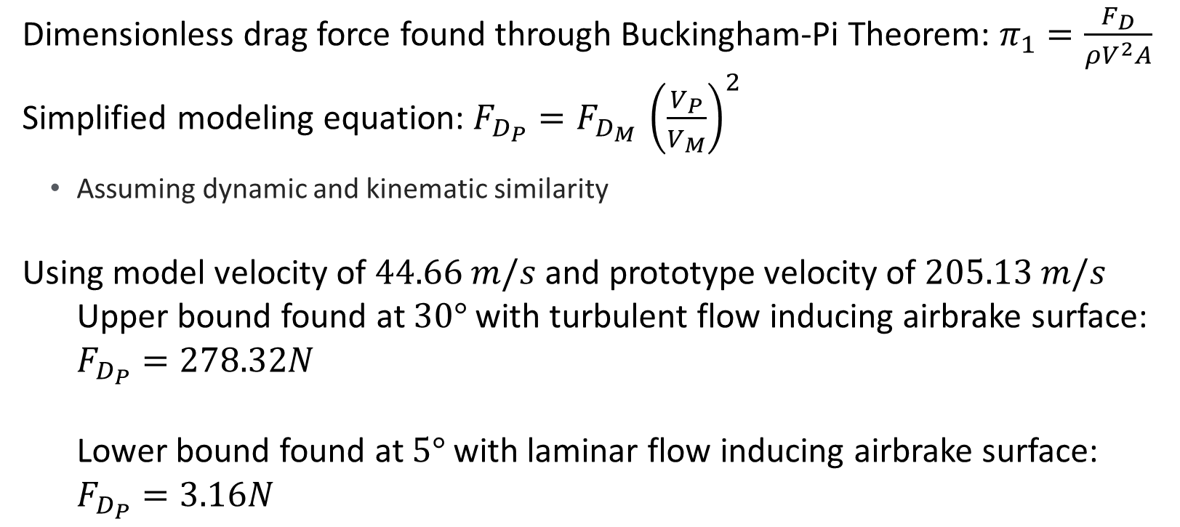
Implications
Dimensionless drag force found through Buckingham-Pi Theorem: $π_{1}=\frac{F_{D}}{ρV^{2}A}$
Simplified modeling equation: $F_{D_{P}}=F_{D_{M} }{\left(\frac{V_{P}}{V_{M}}\right)}^{2}$
Assuming dynamic and kinematic similarity
Using model velocity of $44.66 m/s$ and prototype velocity of $205.13 m/s$
Upper bound found at $30°$ with turbulent flow inducing airbrake surface:
$F_{D_{P}}=278.32N$
Lower bound found at $5°$ with laminar flow inducing airbrake surface:
$F_{D_{P}}=3.16N$
Notes:
Model geometry/area doesn’t change and air density doesn’t change. Max drag at 30 with turbulent Prototype velocity is rocket velocity when airbrake is intended to be deployed

Slide 10
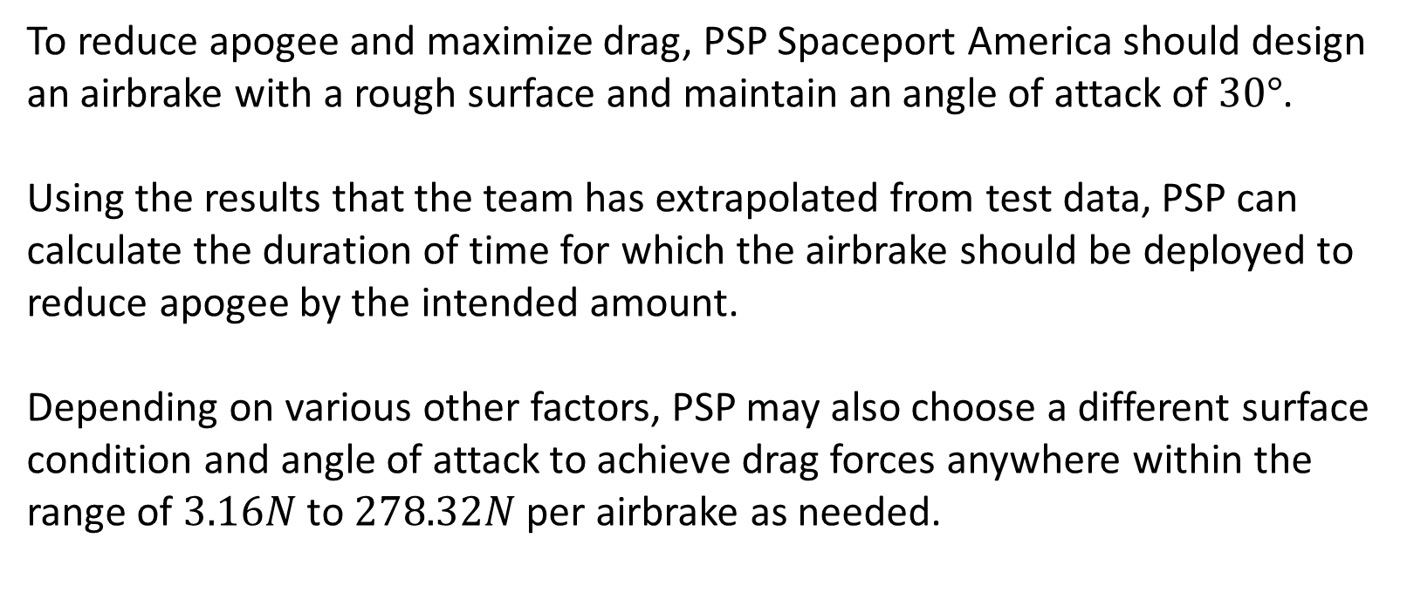
Summary
To reduce apogee and maximize drag, PSP Spaceport America should design an airbrake with a rough surface and maintain an angle of attack of $30°$.
Using the results that the team has extrapolated from test data, PSP can calculate the duration of time for which the airbrake should be deployed to reduce apogee by the intended amount.
Depending on various other factors, PSP may also choose a different surface condition and angle of attack to achieve drag forces anywhere within the range of $3.16N$ to $278.32N$ per airbrake as needed.
Notes:
Rough surface to induce turbulent flow and aoa of 30 to maximize frontal projected area and drag

Slide 11
Thank You

